Slide 1
18CSC202J - Syllabus
Unit 3 :
Single and Multiple Inheritance - Multilevel inheritance - Hierarchical - Hybrid Inheritance - Advanced Functions - Inline - Friend - Virtual -Overriding - Pure virtual function -Abstract class and Interface -UML State Chart Diagram - UML Activity Diagram

Slide 2
Inheritence
The capability of a class to derive properties and characteristics from another class is called Inheritance. Inheritance is one of the most important features of Object-Oriented Programming.

Slide 3
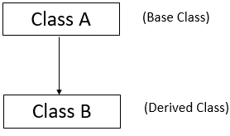
When derived class inherits the base class, it means, the derived class inherits all the properties of the base class, without changing the properties of base class and may add new features to its own.
These new features in the derived class will not affect the base class. The derived class is the specialized class for the base class.
Sub Class: The class that inherits properties from another class is called Subclass or Derived Class or Child Class
Super Class: The class whose properties are inherited by a subclass is called Base Class or Superclass or Parent Class.

Slide 4
Advantages of Inheritence
Reusability: inheritance helps the code to be reused in many situations.
Using the concept of inheritance,the programmer can create as many derived classes from the base class as needed while adding specific features to each derived class as needed.
Saves Time and Effort:The above concept of reusability achieved by inheritance saves the programmer time and effort.The main code written can be reused in various situations as needed.

Slide 5
Modes of Inheritence
The visibility mode (private, public or protected) in the definition of the derived class specifies whether the features of the base class are privately derived, publicly derived or protected derived.
The visibility modes control the access-specifier to be for inheritable members of base-class, in the derived class.
Public Mode
Private Mode
Protected Mode

Slide 6
Publicly Visbility Modes of Inheritence
Public Visibility mode gives the least privacy to the attributes of the base class.
If the visibility mode is public, it means that the derived class can access the public and protected members of the base class, but not the private members of the base class.

Slide 7
Publicly Visbility Modes of Inheritence

Slide 8
Privately Visbility Modes of Inheritence
Public Visibility mode gives the most privacy to the attributes of the base class.
If the visibility mode is private, that means that the derived class can privately access the public and protected members of the base class.

Slide 9
Privately Visbility Modes of Inheritence

Slide 10
Protected Visbility Modes of Inheritence
Protected visibility mode is somewhat between the public and private modes.
If the visibility mode is protected, that means the derived class can access the public and protected members of the base class protectively.

Slide 11
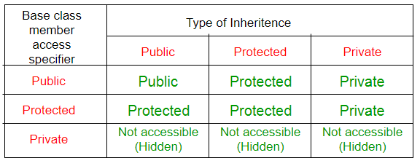
Visbility Modes of Inheritence

Slide 12
Types of Inheritance

Slide 13


Inheritance
Inheritance is the capability of one class to acquire properties and characteristics from another class. The class whose properties are inherited by other class is called the Parent or Base or Super class. And, the class which inherits properties of other class is called Child or Derived or Sub class.
01
Definition
02
Syntax
Single Inheritance, Multiple Inheritance, Hierarchical Inheritance, Multilevel Inheritance, and Hybrid Inheritance (also known as Virtual Inheritance)
Note : All members of a class except Private, are inherited
03
Types
Code Reusability
Method Overriding (Hence, Runtime Polymorphism.)
Use of Virtual Keyword
04
Advantages

Slide 14
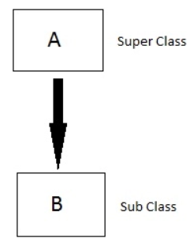
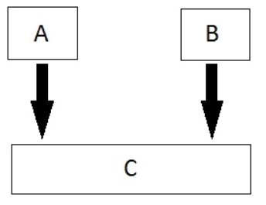
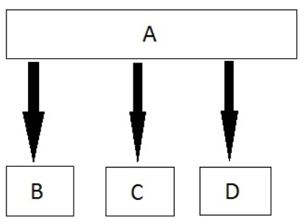
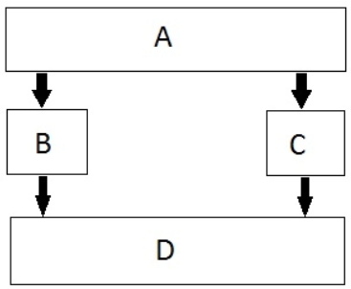
Inheritance Types
01
Single
02
Multiple
03
Hierarchical
04
Multilevel
05
Hybrid

Slide 15
Modes of Inheritance
If we derive a sub class from a public base class. Then the public member of the base class will become public in the derived class and protected members of the base class will become protected in derived class
01
Public
If we derive a sub class from a Protected base class. Then both public member and protected members of the base class will become protected in derived class.
02
Protected
If we derive a sub class from a Private base class. Then both public member and protected members of the base class will become Private in derived class.
03
private
The private members in the base class cannot be directly accessed in the derived class, while protected members can be directly accessed. For example, Classes B, C and D all contain the variables x, y and z in below example
Note:

Slide 16
Inheritance Access Matrix

Slide 17
SINGLE INHERITANCE
Example
Base Class
ClassA
Base Class
Derived Class
Class B
Derived Class

Slide 18
Single Inheritance
In single inheritance, a class is allowed to inherit from only one class. i.e. one sub class is inherited by one base class only. Based on the visibility mode used or access specifier used while deriving, the properties of the base class are derived. Access specifier can be private, protected or public.
Syntax:
class Classname // base class
{
..........
};
class classname: access_specifier baseclassname
{
…
};

Slide 19
Example
#include <iostream>
using namespace std;
class base //single base class
{ public:
int x;
void getdata()
{
cout << "Enter the value of x = ";
cin >> x;
}
};
class derived : public base //single derived
{
int y;
public:
void readdata()
{
cout << "Enter the value of y = ";
cin >> y;
}
void product()
{
cout << "Product = " << x * y;
}
};
int main()
{
derived a; //object of derived class
a.getdata();
a.readdata();
a.product();
return 0;
}

Slide 20
Applications of Single Inheritance
Grading System
University Grading System
Employee and Salary
Student

Slide 21
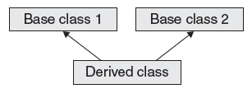
Multiple Inheritance
Base Class
Base Class

Slide 22
Multiple Inheritance
In this type of inheritance a single derived class may inherit from two or more than two base classes.
Syntax:
class A // base class
{
..........
};
class B
{
..........
}
class c : access_specifier A, access_specifier B // derived class
{
...........
} ;

Slide 23
Example:
#include using namespace std;
class sum1
{
protected: int n1;
};
class sum2
{
protected: int n2;
};
class show : public sum1, public sum2
{
public: int total()
{
cout<<“enter n1”;
cin>>n1;
cout<<“enter n2″;
cin>>n2;
cout<<“sum=”<
cout<<“sum=”<<n1+n2<<endl;
}
};
int main()
{
show ob;
ob.total();
}

Slide 24
Applications of Multiple Inhertiance
Distributed Database

Slide 25
MCQ Questions
What are the things are inherited from the base class?
A. Constructor and its destructor
B. Operator=() members
C. Friends
D. All of the above

Slide 26
MCQ Questions
What are the things are inherited from the base class?
A. Constructor and its destructor
B. Operator=() members
C. Friends
D. All of the above

Slide 27
MCQ Questions
using namespace std;
class Base1 {
public:
Base1()
{ cout << " Base1" << endl; }
};
class Base2 {
public:
Base2()
{ cout << "Base2" << endl; }
};
class Derived: public Base1, public Base2 {
public:
Derived()
{ cout << "Derived" << endl; }
};
int main()
{
Derived d;
return 0;
}
A. Compiler Dependent
B. Base1 Base2 Derived
C. Base2 Base1 Derived
D. Compiler Error

Slide 28
MCQ Questions
using namespace std;
class Base1 {
public:
Base1()
{ cout << " Base1" << endl; }
};
class Base2 {
public:
Base2()
{ cout << "Base2" << endl; }
};
class Derived: public Base1, public Base2 {
public:
Derived()
{ cout << "Derived" << endl; }
};
int main()
{
Derived d;
return 0;
}
A. Compiler Dependent
B. Base1 Base2 Derived
C. Base2 Base1 Derived
D. Compiler Error

Slide 29
MCQ Questions
class ABC is derived from Class X, class Y and class Z . This is ______ inheritance.
A. Multiple
B. Multilevel
C. Hierarchical
D. Single

Slide 30
MCQ Questions
class ABC is derived from Class X, class Y and class Z . This is ______ inheritance.
A. Multiple
B. Multilevel
C. Hierarchical
D. Single

Slide 31
Multilevel Inheritance
A derived class can be derived from another derived class. A child class can be the parent of another class.
Syntax:
class A // base class
{
..........
};
class B
{
..........
}
class C : access_specifier B
// derived class
{
...........
} ;

Slide 32
// base class
class Vehicle
{
public:
Vehicle()
{
cout << "This is a Vehicle";
}
};
class fourWheeler: public Vehicle
{ public:
fourWheeler()
{
cout<<"Objects with 4 wheels are vehicles"<<endl;
}
};
// sub class derived from two base classes
class Car: public fourWheeler{
public:
car()
{
cout<<"Car has 4 Wheels”;
}
};
// main function
int main()
{
//creating object of sub class will
//invoke the constructor of base classes
Car obj;
return 0;
}

Slide 33
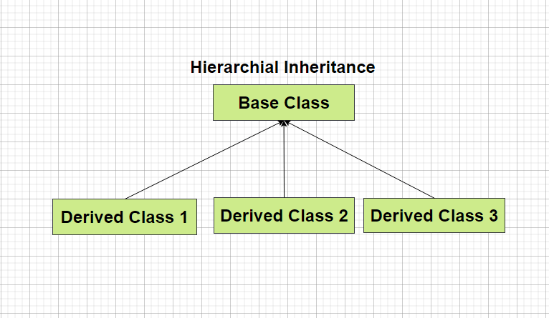
Hierarichal Inheritance
In Hierarichal Inheritance we have several classes that are derived from a common base class (or parent class).
Here in the diagram Class 1, Class 2 and Class 3 are derived from a common parent class called Base Class.

Slide 34
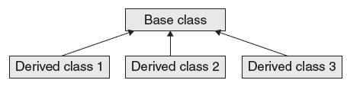
Hierarchical Inheritance

Slide 35
How to implement Hierarchal Inheritance in C++
class A {
// Body of Class A
}; // Base Class
class B : access_specifier A
{
// Body of Class B
}; // Derived Class
class C : access_specifier A
{
// Body of Class C
}; // Derived Class
In the example present in the left we have class A as a parent class and class B and class C that inherits some property of Class A.
While performing inheritance it is necessary to specify the access_specifier which can be public, private or protected.

Slide 36
Example
#include <iostream>
using namespace std;
class A //single base class
{
public:
int x, y;
void getdata()
{
cout << "\nEnter value of x and y:\n";
cin >> x >> y;
}
};
class B : public A //B is derived from class base
{
public:
void product()
{
cout << "\nProduct= " << x * y;
}
};
class C : public A //C is also derived from class base
{
public:
void sum()
{
cout << "\nSum= " << x + y;
}
};
int main()
{
B obj1; //object of derived class B
C obj2; //object of derived class C
obj1.getdata();
obj1.product();
obj2.getdata();
obj2.sum();
return 0;
}

Slide 37
Example of Hierarchical Inheritance
class Car {
public:
int wheels = 4;
void show() {
cout << "No of wheels : "<<wheels ;
}
};
class Audi: public Vehicle {
public:
string brand = "Audi";
string model = “A6”;
};
class Volkswagen: public Car {
public:
string brand = "Volkswagen";
string model = “Beetle”;
};
class Honda: public Car {
public:
string brand = "Honda";
string model = “City”;
};

Slide 38

MCQ
What is the minimum number of levels for a implementing multilevel inheritance? a) 1 b) 2 c) 3 d) 4
Ans(C)
2. In multilevel inheritance one class inherits _______________ a) Only one class b) More than one class c) At least one class d) As many classes as required
Ans(a)

Slide 39
3. Can abstract classes be used in multilevel inheritance? a) Yes, always b) Yes, only one abstract class c) No, abstract class doesn’t have constructors d) No, never
Ans(a)
4. How many abstract classes can be used in multilevel inheritance? a) Only 1 b) Only 2 c) At least one less than number of levels d) Can’t be used
Ans(c)

Slide 40
5. Is it compulsory for all the classes in multilevel inheritance to have constructors defined explicitly if only last derived class object is created? a) Yes, always b) Yes, to initialize the members c) No, it not necessary d) No, Constructor must not be defined
Ans(c)

Slide 41
Hybrid Inheritance

Slide 42
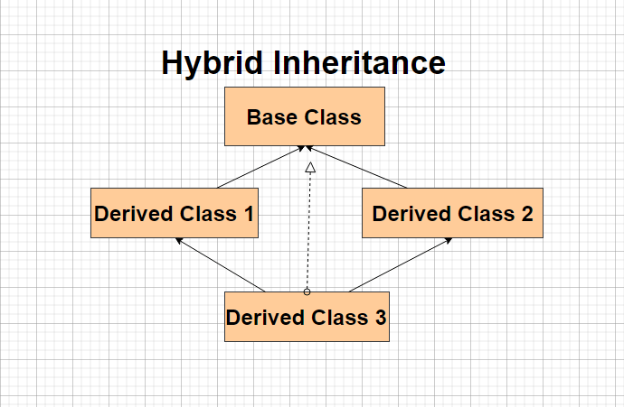
Hybrid Inheritance
Hybrid Inheritance involves derivation of more than one type of inheritance.
Like in the given image we have a combination of hierarichal and multiple inheritance.
Likewise we can have various combinations.

Slide 43
Diagramatic Representation of Hybrid Inheritance

Slide 44
How to implement Hybrid Inheritance in C++
class A
{
// Class A body
};
class B : public A
{
// Class B body
} ;
class C
{
// Class C body
};
class D : public B, public C
{ // Class D body
};
Hybrid Inheritance is no different than other type of inheritance.
You have to specify the access specifier and the parent class in front of the derived class to implement hybrid inheritance.

Slide 45
Access Specifiers
In C++ we have basically three types of access specifiers :
Public : Here members of the class are accessible outside the class as well.
Private : Here members of the class are not accessible outside the class.
Protected : Here the members cannot be accessed outside the class, but can be accessed in inherited classes.

Slide 46
Example of Hybrid Inheritance
class A
{
public:
int x;
};
class B : public A
{
public:
B()
{
x = 10;
}
};
class C
{ public:
int y;
C()
{
y = 4;
}
};
class D : public B, public C
{ public:
void sum()
{
cout << "Sum= " << x + y;
}
};

Slide 47
Order of Constructor Call
Base class constructors are always called in the derived class constructors. Whenever you create derived class object, first the base class default constructor is executed and then the derived class's constructor finishes execution.
Points to Remember
Whether derived class's default constructor is called or parameterised is called, base class's default constructor is always called inside them.
To call base class's parameterised constructor inside derived class's parameterised constructor, we must mention it explicitly while declaring derived class's parameterized constructor.

Slide 48
Example
class Base
{
int x;
public:
Base()
{
cout<<"Base default constructor";
}
};
class Derived : public Base
{
int y;
public:
Derived()
{
cout<"Derived def. constructor";
}
// parameterized constructor
Derived(int i)
{
cout << "Derived parameterized constructor\n";
}
};
int main()
{
Base b;
Derived d1;
Derived d2(10);
}

Slide 49
Order of Constructor Call
class Base
{
int x;
public:
// parameterized constructor
Base(int i)
{
x = i;
cout<<"BaseParameterized Constructor\n";
}
};
class Derived : public Base
{
int y;
public:
// parameterized constructor
Derived(int j):Base(j)
{
y = j;
cout << "Derived Parameterized Constructor\n";
}
};
int main()
{
Derived d(10) ;
}
Example:

Slide 50
Note:
Constructors have a special job of initializing the object properly. A Derived class constructor has access only to its own class members, but a Derived class object also have inherited property of Base class, and only base class constructor can properly initialize base class members. Hence all the constructors are called, else object wouldn't be constructed properly.

Slide 51
Constructors and Destructors are never inherited and hence never overridden.
Also, assignment operator = is never inherited. It can be overloaded but can't be inherited by sub class.
Concept
01
They are inherited into the derived class.
If you redefine a static member function in derived class, all the other overloaded functions in base class are hidden.
Static Member functions can never be virtual.
02
Static Function
Derived class can inherit all base class methods except:
Constructors, destructors and copy constructors of the base class.
Overloaded operators of the base class.
The friend functions of the base class.
03
Limitation

Slide 52
Calling base and derived class method using base reference
Example:
#include <iostream>
using namespace std;
class Foo
{
public:
int x;
virtual void printStuff()
{
cout<<"BaseFoo printStuff called"<<endl;
}
};
class Bar : public Foo
{
public:
int y;
void printStuff()
{
cout<<"derived Bar printStuff called"<<endl;
}
};
int main()
{
Foo *foo=new Foo;
foo->printStuff();/////this call the base function
foo=new Bar;
foo->printStuff();
}
Output:
Base Foo printStuff called
derived Bar printStuff called

Slide 53
Calling base and derived class method using derived reference
Example:
#include <iostream>
class Base{
public:
void foo()
{
std::cout<<"base";
}
};
class Derived : public Base
{
public:
void foo()
{
std::cout<<"derived";
}
};
int main()
{
Derived bar;
//call Base::foo() from bar here?
bar.Base::foo(); // using a qualified-id
return 0;
}
Output:
base

Slide 54
Advanced Functions: Inline, Friend,
Virtual function and Overriding

Slide 55
Inline Member Function
Inline functions are used in C++ to reduce the overhead of a normal function call.
A member function that is both declared and defined in the class member list is called an inline member function.
The inline specifier is a hint to the compiler that inline substitution of the function body is to be preferred to the usual function call implementation.
The advantages of using inline member functions are:
1. The size of the object code is considerably reduced.
2. It increases the execution speed, and
3. The inline member function are compact function calls.

Slide 56
Inline Member Function
Syntax:
class user_defined_name
{
private:
-------------
public:
inline return_type function_name(parameters);
inline retrun_type function_name(parameters);
---------------
---------------
};
Syntax
Inline return_type function_name(parameters)
{
----------------
----------------
}

Slide 57
Inline function and classes
It is also possible to define the inline function inside the class.
All the functions defined inside the class are implicitly inline. Thus, all the restrictions of inline functions are also applied here.
If you need to explicitly declare inline function in the class then just declare the function inside the class and define it outside the class using inline keyword

Slide 58
#include <iostream>
using namespace std;
class operation
{
int a,b,add;
public:
void get();
void sum();
};
inline void operation :: get()
{
cout << "Enter first value:";
cin >> a;
cout << "Enter second value:";
cin >> b;
}
inline void operation :: sum()
{
add = a+b;
cout << "Addition of two numbers: " << a+b << "\n";
}
int main()
{
cout << "Program using inline function\n";
operation s;
s.get();
s.sum();
return 0;
}
Output:
Enter first value: 45 Enter second value: 15 Addition of two numbers: 60 Difference of two numbers: 30 Product of two numbers: 675 Division of two numbers: 3

Slide 59
Friend Function
1. The main concepts of the object oriented programming paradigm are data hiding and data encapsulation.
2. Whenever data variables are declared in a private category of a class, these members are restricted from accessing by non – member functions.
3. The private data values can be neither read nor written by non – member functions.
4. If any attempt is made directly to access these members, the compiler will display an error message as “inaccessible data type”.
5. The best way to access a private data member by a non – member function is to change a private data member to a public group.
6. When the private or protected data member is changed to a public category, it violates the whole concept or data hiding and data encapsulation.
7. To solve this problem, a friend function can be declared to have access to these data members.
8. Friend is a special mechanism for letting non – member functions access private data.
9. The keyword friend inform the compiler that it is not a member function of the class.

Slide 60
Friend Function
Granting Friendship to another Class
1. A class can have friendship with another class.
2. For Example, let there be two classes, first and second. If the class first grants its friendship with the other class second, then the private data members of the class first are permitted to be accessed by the public members of the class second. But on the other hand, the public member functions of the class first cannot access the private members of the class second.
Syntax
01
class second; forward declaration
class first
{
private:
--------------

Slide 61
Friend Function
Two classes having the same Friend
1. A non – member function may have friendship with one or more classes.
2. When a function has declared to have friendship with more than one class, the friend classes should have forward declaration.
3. It implies that it needs to access the private members of both classes.
Syntax
01
friend return_type function_name(parameters);
Example
02
friend return_type fname(first one, second two)
{}
Note:
where friend is a keyword used as a function modifier. A friend declaration is valid only within or outside the class definition.
03

Slide 62
Friend Function
Syntax:
class second; forward declaration
class first
{
private:
--------------
public:
friend return_type fname(first one, second two);
};
class second
{
private:
------------------
public:
friend return_type fname(first one, second two);
};
Case 2:
class sample
{
private:
int x;
float y;
public:
virtual void display();
virtual static int sum(); //error
}
int sample::sum()
{ }

Slide 63
Friend Function Example
Example:
class sample
{
private:
int x;
public:
void getdata();
friend void display(sample abc);
};
void sample::getdata()
{
cout<<"Enter a value for x\n"<<endl;
cin>>x;
}
void display(sample abc)
{
cout<<"Entered Number is "<<abc.x<<endl;
}
void main()
{
clrscr();
sample obj;
obj.getdata();
cout<<"Accessing the private data by non - member function"<<endl;
display(obj);
getch();
}*/

Slide 64
Friend Function Example
Example:
class first
{
friend class second;
private:
int x;
public:
void getdata();
};
class second
{
public:
void disp(first temp);
};
void first::getdata()
{
cout<<"Enter a Number ?"<<endl;
cin>>x;
}
void second::disp(first temp)
{
cout<<"Entered Number is = "<<temp.x<<endl;
}
void main()
{
first objx;
second objy;
objx.getdata();
objy.disp(objx);
}

Slide 65
Friend Function Example
class second; //Forward Declaration
class first
{
private:
int x;
public:
void getdata();
void display();
friend int sum(first one,second two);
};
class second
{
private:
int y;
public:
void getdata();
void display();
friend int sum(first one,second two);
};
void first::getdata()
{
cout<<"Enter a Value for X"<<endl;
cin>>x;
}
void second::getdata()
{
cout<<"Enter a value for Y"<<endl;
cin>>y;
}
void first::display()
{
cout<<"Entered Number is X = ";
}
void second::display()
{
cout<<"Entered Number is Y = ";
}
int sum (first one,second two)
{
int temp;
temp = one.x + two.y;
return(temp);
}
void main()
{
first a;
second b;
a.getdata();
b.getdata();
a.display();
b.display();
int te = sum(a,b);
cout<<"Sum of the two Private data variable (X + Y)";
cout<<" = "<<te<<endl;
}

Slide 66
Virtual function
Virtual Function is a function in base class, which is overridden in the derived class, and which tells the compiler to perform Late Binding on this function.
Virtual Keyword is used to make a member function of the base class Virtual. Virtual functions allow the most specific version of a member function in an inheritance hierarchy to be selected for execution. Virtual functions make polymorphism possible.
Key:
Only the Base class Method's declaration needs the Virtual Keyword, not the definition.
If a function is declared as virtual in the base class, it will be virtual in all its derived classes.
Syntax
01
virtual return_type function_name (arg);
Example
02
virtual void show()
{
cout << "Base class\n";
}
Note:
We can call private function of derived class from the base class pointer with the help of virtual keyword. Compiler checks for access specifier only at compile time. So at run time when late binding occurs it does not check whether we are calling the private function or public function.
03

Slide 67
Virtual function features
Case 1:
class sample
{
private:
int x;
float y;
public:
virtual void display();
virtual int sum();
}
virtual void sample::display() //Error
{ }
Case 2:
class sample
{
private:
int x;
float y;
public:
virtual void display();
virtual static int sum(); //error
}
int sample::sum()
{ }

Slide 68
Virtual function features
Case 3:
class sample
{
private:
int x;
float y;
public:
virtual sample(int x,float y); //constructor
void display();
int sum();
}
Case 4:
class sample
{
private:
int x;
float y;
public:
virtual ~sample(int x,float y); //invalid
void display();
int sum();
}

Slide 69
Virtual function features
Case 5:
class sample_1
{
private:
int x;
float y;
public:
virtual int sum(int x,float y); //error
};
class sample_2:public sample_1
{
private:
int z;
public:
virtual float sum(int xx,float yy);
};
Case 6:
virtual void display() //Error, non member function
{
----------------
----------------
}

Slide 70
Virtual Function Example
Example:
class Point
{
protected:
float length,breath,side,radius,area,height;
};
class Shape: public Point
{
public:
virtual void getdata()=0;
virtual void display()=0;
};
class Rectangle:public Shape
{
public:
void getdata()
{
cout<<"Enter the Breadth Value:"<<endl;
cin>>breath;
cout<<"Enter the Length Value:"<<endl;
cin>>length;
}
void display()
{
area = length * breath;
cout<<"The Area of the Rectangle is:"<<area<<endl;
}
};
class Square:public Shape
{
public:
void getdata()
{
cout<<"Enter the Value of the Side of the Box:"<<endl;
cin>>side;
}
void display()
{
area = pow(side,4);
cout<<"The Area of the Square is:"<<area<<endl;
}
};
void main()
{
Shape *s;
Rectangle r;
Triangle t;
s = &r;
s->getdata();
s->display();
s = &t;
s->getdata();
s->display();
}

Slide 71
Difference in invocation for virtual and non virtual function
class Base
{ public:
void show()
{
cout << "Base class";
}
};
class Derived:public Base
{ public:
void show()
{
cout << "Derived Class";
}
}
int main()
{
Base* b; //Base class pointer
Derived d; //Derived class object
b = &d;
b->show(); //Early Binding Occurs
}
class Base
{ public:
virtual void show()
{
cout << "Base class\n";
} };
class Derived:public Base
{ public:
void show()
{
cout << "Derived Class";
} };
int main()
{
Base* b; //Base class pointer
Derived d; //Derived class object
b = &d;
b->show(); //Late Binding Occurs
}
Example:

Slide 72
Difference in invocation for virtual and non virtual function
Example:
#include<iostream>
using namespace std;
class Base {
public:
void foo()
{
std::cout << "Base::foo\n";
}
virtual void bar()
{
std::cout << "Base::bar\n";
}
};
class Derived : public Base {
public:
void foo()
{
std::cout << "Derived::foo\n";
}
virtual void bar()
{
std::cout << "Derived::bar\n";
}
};
int main() {
Derived d;
Base* b = &d;
b->foo(); // calls Base::foo
b->bar(); // calls Derived::bar
}
Output:
Base::foo
Derived::bar

Slide 73
Override
Example:
#include <iostream>
using namespace std;
class Base {
public:
// user wants to override this in the derived class
virtual void func()
{
cout << "I am in base" << endl;
}
};
class derived : public Base {
public:
// did a mistake by putting an argument "int a"
void func(int a) override
{
cout << "I am in derived class" << endl;
}
};
int main()
{
Base b;
derived d;
cout << "Compiled successfully" << endl;
return 0;
}
Output:
Base::foo
Derived::bar

Slide 74
Pure Virtual function
Pure virtual Functions are virtual functions with no definition. They start with virtual keyword and ends with = 0. Here is the syntax for a pure virtual function.
Pure Virtual functions can be given a small definition in the Abstract class, which you want all the derived classes to have. Still you cannot create object of Abstract class.
Also, the Pure Virtual function must be defined outside the class definition. If you will define it inside the class definition, complier will give an error. Inline pure virtual definition is Illegal.
Abstract Class is a class which contains atleast one Pure Virtual function in it. Abstract classes are used to provide an Interface for its sub classes. Classes inheriting an Abstract Class must provide definition to the pure virtual function, otherwise they will also become abstract class.
Syntax
01
virtual void f() = 0;
Example
class Base
{
public:
virtual void show() = 0; // Pure Virtual Function
};
02
Note:
We can call private function of derived class from the base class pointer with the help of virtual keyword. Compiler checks for access specifier only at compile time. So at run time when late binding occurs it does not check whether we are calling the private function or public function.
03

Slide 75
Pure Virtual function
Example:
class pet
{
private:
char name[5];
public:
virtual void getdata()=0;
virtual void display()=0;
};
class fish:public pet
{
private:
char environment[10];
char food[10];
public:
void getdata();
void display();
};
class dog: public pet
{
private:
char environment[10];
char food[10];
public:
void getdata();
void display();
};
void fish::getdata()
{
cout<<"Enter the Fish Environment required"<<endl;
cin>>environment;
cout<<"Enter the Fish food require"<<endl;
cin>>food;
}
void fish::display()
{
cout<<"Fish Environment="<<environment<<endl;
cout<<"Fish Food="<<food<<endl;
cout<<"-------------------------------------"<<endl;
}

Slide 76
Pure Virtual function
Example:
void dog::getdata()
{
cout<<"Enter the Dog Environment required"<<endl;
cin>>environment;
cout<<"Enter the Dog Food require"<<endl;
cin>>food;
}
void dog::display()
{
cout<<"Dog Environment="<<environment<<endl;
cout<<"Dog Food="<<food<<endl;
cout<<"---------------------------------------"<<endl;
}
void main()
{
pet *ptr;
fish f;
ptr=&f;
ptr->getdata();
ptr->display();
dog d;
ptr=&d;
ptr->getdata();
ptr->display();
getch();
}

Slide 77
Abstract Class
Abstract class cannot be instantiated, but pointers and references of Abstract class type can be created.
Abstract class can have normal functions and variables along with a pure virtual function.
Abstract classes are mainly used for Upcasting, so that its derived classes can use its interface.
Classes inheriting an Abstract Class must implement all pure virtual functions, or else they will become Abstract too.

Slide 78
Pure virtual function
Example:
/Abstract base class
class Base
{
public:
virtual void show() = 0; // Pure Virtual Function
};
class Derived:public Base
{
public:
void show()
{
cout << "Implementation of Virtual Function in Derived class\n";
}
};
int main()
{
Base obj; //Compile Time Error
Base *b;
Derived d;
b = &d;
b->show();
}

Slide 79
Abstract Class

Slide 80
Abstract Class
Abstract Class is a class which contains atleast one Pure Virtual function(abstract method) in it. Abstract classes are used to provide an Interface for its sub classes. Classes inheriting an Abstract Class must provide definition to the pure virtual function, otherwise they will also become abstract class.
Characteristics of Abstract Class
1. Abstract class cannot be instantiated, but pointers and references of Abstract class type can
be created.
2. Abstract class can have normal functions and variables along with a pure virtual function.
3. Abstract classes are mainly used for Upcasting, so that its derived classes can use its
interface.
4. Classes inheriting an Abstract Class must implement all pure virtual functions, or else
they will become Abstract too.

Slide 81
Abstract Class
Pure Virtual Functions
Pure virtual Functions are virtual functions with no definition. They start with virtual keyword and ends with = 0. Here is the syntax for a pure virtual function,
virtual void funname() = 0;

Slide 82
Example 1
class Base //Abstract base class
{
public:
virtual void show() = 0; //Pure Virtual Function
};
class Derived:public Base
{
public:
void show()
{
cout <<“Implementation of Virtual Function in Derived class”;
}
};
int main()
{
Base obj; //Compile Time Error
Base *b;
Derived d;
b = &d;
b->show();
}
Output : Implementation of Virtual Function in Derived class
In the above example Base class is abstract, with pure virtual show() function, hence we cannot create object of base class.

Slide 83
Example2
int main() {
Square square;
Circle circle;
cout << "Enter the length of the square: ";
square.getDimension();
cout << "Area of square: " << square.calculateArea() << endl;
cout << "\nEnter radius of the circle: ";
circle.getDimension();
cout << "Area of circle: " << circle.calculateArea() << endl;
return 0;
}
// C++ program to calculate the area of a square and a circle
#include <iostream>
using namespace std;
// Abstract class
class Shape {
protected:
float dimension;
public:
void getDimension() {
cin >> dimension;
}
// pure virtual Function
virtual float calculateArea() = 0;
};
// Derived class
class Square : public Shape {
public:
float calculateArea() {
return dimension * dimension; }
};
// Derived class
class Circle : public Shape {
public:
float calculateArea() {
return 3.14 * dimension * dimension;
}
};
Output
Enter the length of the square: 4
Area of square: 16
Enter radius of the circle: 5
Area of circle: 78.5

Slide 84
What will be the output of the following program?
#include <iostream>
#include <string>
using namespace std;
class Exam
{
int a;
public:
virtual void score() = 0;
};
class FirstSemExam: public Exam
{
public:
void score(){
cout<<“First Semester Exam"<<endl;
}
};
int main(int argc, char const *argv[])
{
Exam e;
e.score();
return 0;
}
a) Class B b) Error c) Segmentation fault d) No output
For abstract class Exam object cannot be instantiated

Slide 85
Quiz
Which class supports run-time polymorphism?
a. Base class b. abstract class c. derived class d. subclass
Identify the syntax for pure virtual function
a. void area();
b. void area()=0;
c. void area()=1;
d. pure void area();
3. Can we create object for abstract class? State Yes/No.
4. Identify the incorrect statement with respect to abstract class
a. all functions must be pure virtual function
b. Incomplete type
c. foundation for derived class
d. supports run-time polymorphism
5. If there is an abstract method in a class then, ________________
Class may or may not be abstract class
Class is generic
Class must be abstract class
Class must be public
No

Slide 86
Practice Questions
1.Given an abstract base class Car with member variables and functions:
String name;
//abstract methods
Price()
Discount()
totalseats()
You have to write a class Tata which extends the class Car and uses the member functions and variables to implement price, discount of 20% and total seats.
2. Create an abstract class 'Bank' with an abstract method 'getBalance'. $100, $150 and $200 are deposited in banks A, B and C respectively. 'BankA', 'BankB' and 'BankC' are subclasses of class 'Bank', each having a method named 'getBalance'. Call this method by creating an object of each of the three classes.

Slide 87
Interface

Slide 88
An interface describes the behavior or capabilities of a C++ class without committing to a particular implementation of that class.
The C++ interfaces are implemented using abstract classes and these abstract classes should not be confused with data abstraction which is a concept of keeping implementation details separate from associated data.
A class is made abstract by declaring at least one of its functions as pure virtual function.
A pure virtual function is specified by placing "= 0" in its declaration

Slide 89
Every method declared by an object specifies the method’s name, the object/value it takes as parameters, and the method’s return valuew. this is known as the operation Signature
The set of all signatures defined by an object’s methods is called the interface to the object .An object’s interface characterizes the complete set of requests that can be sent to the object.
An interface is like an abstract class that cannot be instantiated,
Interface are better suited to situations in which your applications require many possibly unrelated object types to provide certain functionality
Explicitly implementing interface in a class enables us to define a set of methods that are mandatory for that class.
Interface definition begins with the keyword interface

Slide 90
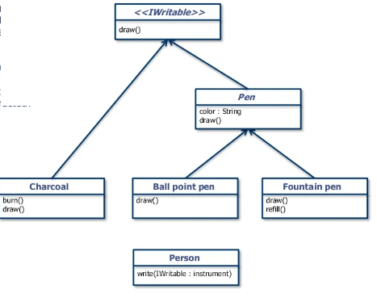
Interface Example
Fountain pen and ball point pen are used for writing, they are related entities. What should be the abstract class for these entities ?
We can Write using pen but we can also write with charcoal. Over here what is the common behaviour between pen and charcoal that can be abstracted?

Slide 91
class Box {
public:
// pure virtual function
virtual double getVolume() = 0;
private:
double length; // Length of a box
double breadth; // Breadth of a box
double height; // Height of a box
};

Slide 92
When to use Interface?
Use an interface when an immutable contract is really intended .
Interfaces are better suited in situations when your applications require many possibly unrelated object types to provide certain functionality.
Interfaces are better in situations in which you do not need to inherit implementation from a base class.
Interfaces can be used for multiple inheritance.

Slide 93
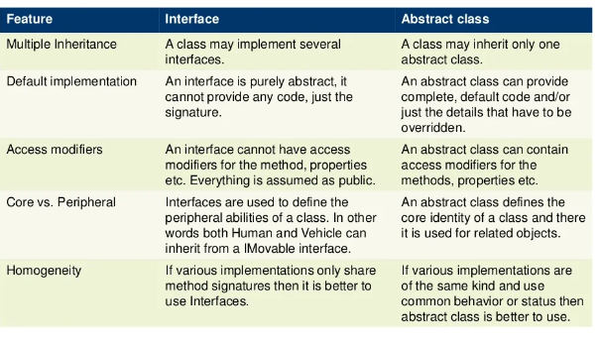
Difference between abstract class and interface

Slide 94
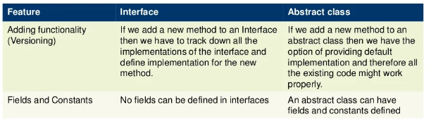
Difference between abstract class and interface

Slide 95
What is similar to interface in c++
A. methods
B. instance of class
C. pure abstract class
D. friend function

Slide 96
Which of the following is used to implement the c++ interfaces?
A. absolute variables
B. abstract classes
C. Constant variables
D. default variables

Slide 97
18CSC202J- Object Oriented Design and Programming
Unit III
UML Start Chart Diagram

Slide 98
Agenda : 1) To understand about behavioral diagram 2) To draw state chart diagram using Star UML .

Slide 99
Introduction
To model dynamic aspect of a system.
To model life time of a reactive system.
To describe different states of an object during its life time.
Define a state machine to model states of an object.

Slide 100
State Diagram
A state diagram is used to represent the condition of the system or part of the system at finite instances of time.
It’s a behavioral diagram and it represents the behavior using finite state transitions.
State diagrams are also referred to as State machines and state-chart Diagrams.

Slide 101
Difference between state chart and flowchart
The basic purpose of a state diagram is to portray various changes in state of the class and not the processes or commands causing the changes.
However, a flowchart on the other hand portrays the processes or commands that on execution change the state of class or an object of the class.

Slide 102
When to use State charts
So the main usages can be described as:
To model object states of a system.
To model reactive system. Reactive system consists of reactive objects.
To identify events responsible for state changes.
Forward and reverse engineering.

Slide 103
Before drawing a State chart diagram we must have clarified the following points:
Identify important objects to be analyzed.
Identify the states.
Identify the events.

Slide 104
Elements of Start Chart Diagram
Initial State: This shows the starting point of the state chart diagram that is where the activity starts.
State: A state represents a condition of a modelled entity for which some action is performed. The state is indicated by using a rectangle with rounded corners and contains compartments.
Composite state – We use a rounded rectangle to represent a composite state also. We represent a state with internal activities using a composite state.
Transition: It is indicated by an arrow. Transition is a relationship between two states which indicates that Event/ Action an object in the first state will enter the second state and performs certain specified actions.
Self transition – We use a solid arrow pointing back to the state itself to represent a self transition. There might be scenarios when the state of the object does not change upon the occurrence of an event. We use self transitions to represent such cases.
Final State-The end of the state chart diagram is represented by a solid circle surrounded by a circle.

Slide 105

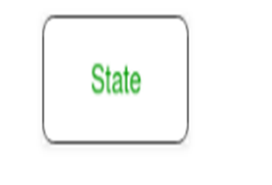

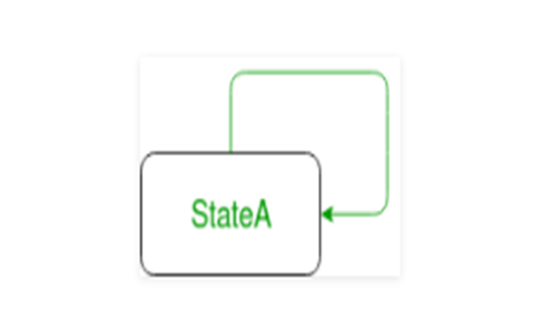
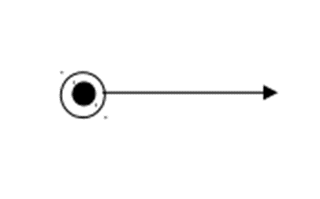
Symbols used in start chart diagram

Slide 106
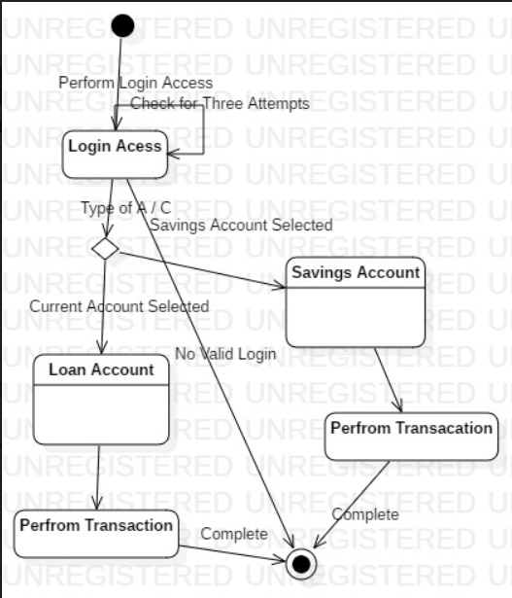
Example – State Chart Diagram

Slide 107
Questions
Which of the statements state the name compartment? a) The first compartment is the name compartment b) It contains the state name; State names are optional and may be path names c) The name compartment can never be omitted d) State name compartment is the first compartment that contains state name, name compartment may be omitted.
2. Start Chart diagram comes under the phase of
Analysis and Design
Design and Implementation
Testing and Deployment
Implementation and Testing

Slide 108
Activity diagram

Slide 109
Activity diagram
Activity diagram is UML behavior diagram which emphasis on the sequence and conditions of the flow
It shows a sequence of actions or flow of control in a system.
It is like to a flowchart or a flow diagram.
It is frequently used in business process modeling. They can also describe the steps in a use case diagram.
The modeled Activities are either sequential or concurrent.

Slide 110
Benefits
It illustrates the logic of an algorithm.
It describes the functions performed in use cases.
Illustrate a business process or workflow between users and the system.
It Simplifies and improves any process by descriptive complex use cases.
Model software architecture elements, such as method, function, and operation.

Slide 111
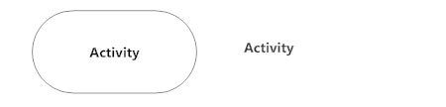
Symbols and Notations
Activity
Is used to illustrate a set of actions.
It shows the non-interruptible action of objects.

Slide 112

Symbols and Notations
Action Flow
It is also called edges and paths
It shows switching from one action state to another. It is represented as an arrowed line.

Slide 113
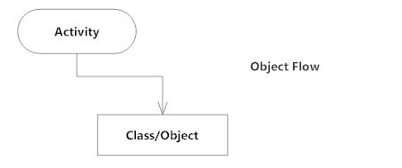
Symbols and Notations
Object Flow
Object flow denotes the making and modification of objects by activities.
An object flow arrow from an action to an object means that the action creates or influences the object.
An object flow arrow from an object to an action indicates that the action state uses the object.

Slide 114

Symbols and Notations
Decisions and Branching
A diamond represents a decision with alternate paths.
When an activity requires a decision prior to moving on to the next activity, add a diamond between the two activities.
The outgoing alternates should be labeled with a condition or guard expression. You can also label one of the paths "else."

Slide 115
Symbols and Notations
Decisions and Branching
A diamond represents a decision with alternate paths.
When an activity requires a decision prior to moving on to the next activity, add a diamond between the two activities.
The outgoing alternates should be labeled with a condition or guard expression. You can also label one of the paths "else."

Slide 116
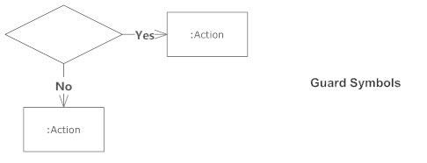
Symbols and Notations
Guards
In UML, guards are a statement written next to a decision diamond that must be true before moving next to the next activity.
These are not essential, but are useful when a specific answer, such as "Yes, three labels are printed," is needed before moving forward.

Slide 117
Symbols and Notations
Synchronization
A fork node is used to split a single incoming flow into multiple concurrent flows. It is represented as a straight, slightly thicker line in an activity diagram.
A join node joins multiple concurrent flows back into a single outgoing flow.
A fork and join mode used together are often referred to as synchronization.

Slide 118
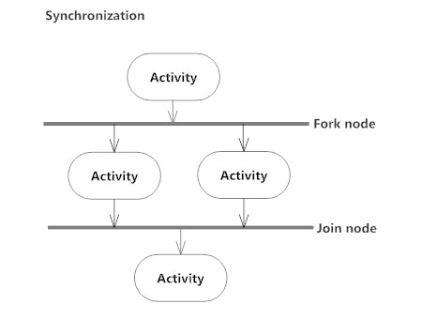
Symbols and Notations
Synchronization

Slide 119
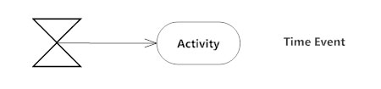
Symbols and Notations
Time Event
This refers to an event that stops the flow for a time; an hourglass depicts it.

Slide 120
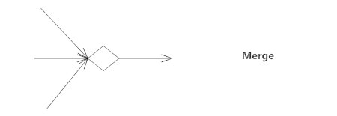

Symbols and Notations
Merge Event
A merge event brings together multiple flows that are not concurrent.
Final State or End Point
An arrow pointing to a filled circle nested inside another circle represents the final action state.

Slide 121
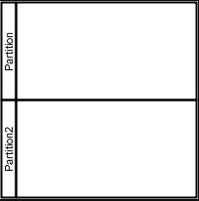
Symbols and Notations
Swimlane and Partition
A way to group activities performed by the same actor on an activity diagram or to group activities in a single thread

Slide 122
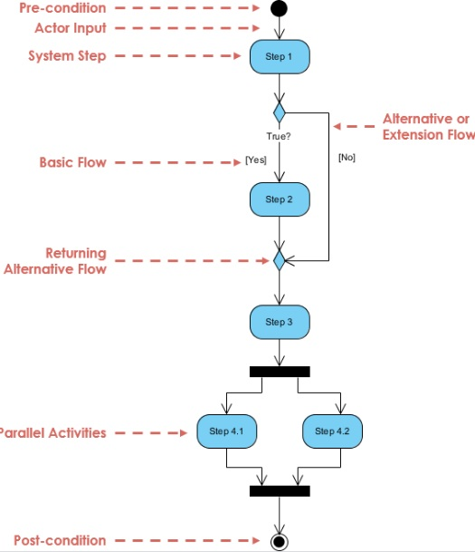
Activity diagram

Slide 123
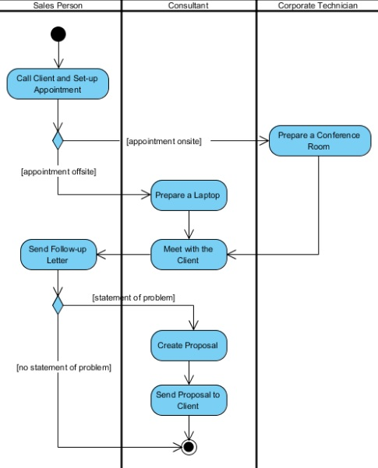
Activity Diagram with Swimlane

Slide 124
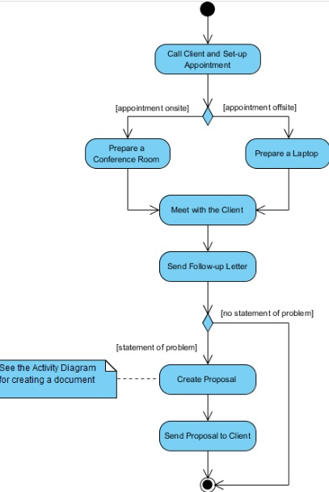
Activity Diagram with Swimlane

Slide 125
Practice Questions- MCQ
Which of the following Combines two concurrent activities and re-introduces them to a flow where only one activity can be performed at a time?
A. Joint symbol
B. Fork symbol
C. Decision symbol
D. Note symbol
Ans: A

Slide 126
Practice Questions- MCQ
In an Activity Diagram, organizing the activities into groups is called ________
A. forking
B. joining
C. swimlane
D. synchronization
Ans: C

Slide 127
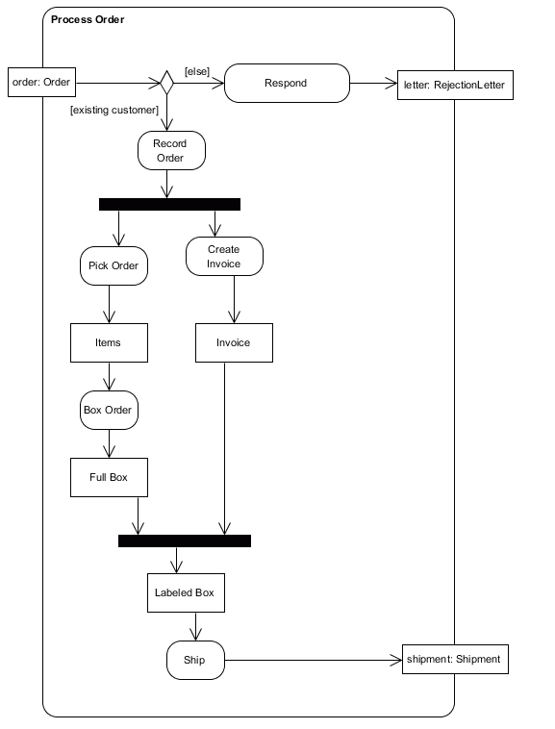
Practice questions
Identify all of the activities in this diagram.
Identify all of the object/data nodes in this diagram.
Identify all of the actions in this diagram.
Identify all of the decision nodes in this diagram.
Identify all of the fork nodes in this diagram.
Identify all of the join nodes in this diagram.
Identify a control flow in this diagram.
Identify a data flow in this diagram.
Can "Pick Order" and "Create Invoice" occur at the same time?
Can "Record Order" and "Ship" occur at the same time?

Slide 128
Thank you

Slide 129
Abstract Class
Abstract class cannot be instantiated, but pointers and references of Abstract class type can be created.
Abstract class can have normal functions and variables along with a pure virtual function.
Abstract classes are mainly used for Upcasting, so that its derived classes can use its interface.
Classes inheriting an Abstract Class must implement all pure virtual functions, or else they will become Abstract too.

Slide 130
Pure virtual function
Example:
/Abstract base class
class Base
{
public:
virtual void show() = 0; // Pure Virtual Function
};
class Derived:public Base
{
public:
void show()
{
cout << "Implementation of Virtual Function in Derived class\n";
}
};
int main()
{
Base obj; //Compile Time Error
Base *b;
Derived d;
b = &d;
b->show();
}

Slide 131
State chart diagram
18CS202J OBJECT ORIENTED DESIGN AND PROGRAMMING

Slide 132
State diagram
A state diagram is used to represent the condition of the system or part of the system at finite instances of time. It’s a behavioural diagram and it represents the behaviour using finite state transitions. State diagrams are also referred to as State machines and State-chart Diagrams.

Slide 133
Uses of state chart diagram
State chart diagrams are useful to model reactive systems
-Reactive systems can be defined as a system that responds to external or internal events.
• State chart diagram describes the flow of control from one state to another state.

Slide 134
Purpose
Following are the main purposes of using State chart diagrams:
To model dynamic aspect of a system.
To model life time of a reactive system.
To describe different states of an object during its life time.
Define a state machine to model states of an object.

Slide 135
Difference between state diagram and flowchart
The basic purpose of a state diagram is to portray various changes in state of the class and not the processes or commands causing the changes.
However, a flowchart on the other hand portrays the processes or commands that on execution change the state of class or an object of the class.

Slide 136
When to use State charts
So the main usages can be described as:
To model object states of a system.
To model reactive system. Reactive system consists of reactive objects.
To identify events responsible for state changes.
Forward and reverse engineering.

Slide 137
How to draw state charts
Before drawing a State chart diagram we must have clarified the following points:
Identify important objects to be analysed.
Identify the states.
Identify the events.

Slide 138

Elements of state chart diagrams
Initial State: This shows the starting point of the state chart diagram that is where the activity starts.

Slide 139

Elements of state chart diagrams
State: A state represents a condition of a modelled entity for which some action is performed. The state is indicated by using a rectangle with rounded corners and contains compartments

Slide 140
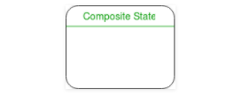
Elements of state chart diagrams
Composite state – We use a rounded rectangle to represent a composite state also. We represent a state with internal activities using a composite state.

Slide 141
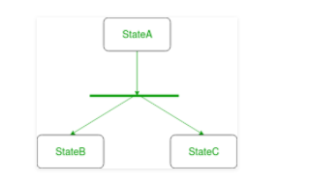
Elements of state chart diagrams
Fork – We use a rounded solid rectangular bar to represent a Fork notation with incoming arrow from the parent state and outgoing arrows towards the newly created states. We use the fork notation to represent a state splitting into two or more concurrent states.

Slide 142
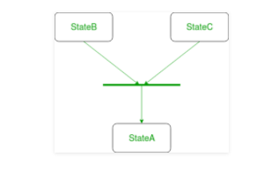
Elements of state chart diagrams
Join – We use a rounded solid rectangular bar to represent a Join notation with incoming arrows from the joining states and outgoing arrow towards the common goal state. We use the join notation when two or more states concurrently converge into one on the occurrence of an event or events.

Slide 143
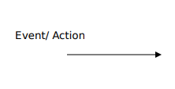
Elements of state chart diagrams
Transition: It is indicated by an arrow. Transition is a relationship between two states which indicates that Event/ Action an object in the first state will enter the second state and performs certain specified actions.

Slide 144

Elements of state chart diagrams
Transition – We use a solid arrow to represent the transition or change of control from one state to another. The arrow is labelled with the event which causes the change in state.

Slide 145
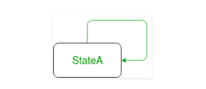
Elements of state chart diagrams
Self transition – We use a solid arrow pointing back to the state itself to represent a self transition. There might be scenarios when the state of the object does not change upon the occurrence of an event. We use self transitions to represent such cases.

Slide 146

Elements of state chart diagrams
Final State: The end of the state chart diagram is represented by a solid circle surrounded by a circle.

Slide 147
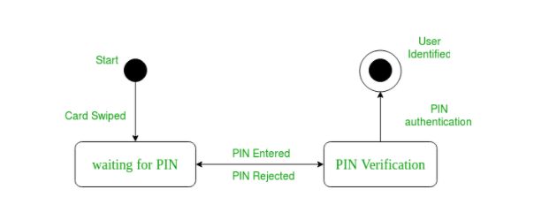
Example state chart for ATM card PIN Verification

Slide 148
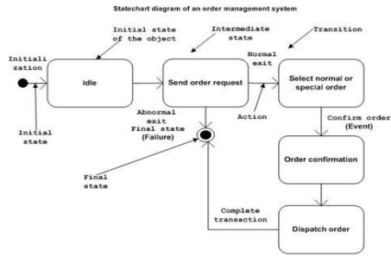
Example state chart for order management system

Slide 149
ACTIVITY DIAGRAM
18CSC202J
Object Oriented Design and Programming

Slide 150
Activity Diagram
Activity diagram is UML behavior diagram which emphasis on the sequence and conditions of the flow
It shows a sequence of actions or flow of control in a system.
It is like to a flowchart or a flow diagram.
It is frequently used in business process modeling. They can also describe the steps in a use case diagram.
The modeled Activities are either sequential or concurrent.

Slide 151
Benefits
It illustrates the logic of an algorithm.
It describes the functions performed in use cases.
Illustrate a business process or workflow between users and the system.
It Simplifies and improves any process by descriptive complex use cases.
Model software architecture elements, such as method, function, and operation.

Slide 152

Symbols and Notations
Activity
Is used to illustrate a set of actions.
It shows the non-interruptible action of objects.

Slide 153

Symbols and Notations
Action Flow
It is also called edges and paths
It shows switching from one action state to another. It is represented as an arrowed line.

Slide 154
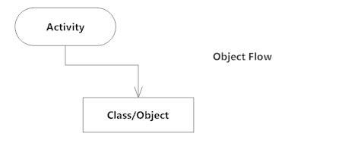
Symbols and Notations
Object Flow
Object flow denotes the making and modification of objects by activities.
An object flow arrow from an action to an object means that the action creates or influences the object.
An object flow arrow from an object to an action indicates that the action state uses the object.

Slide 155

Symbols and Notations
Decisions and Branching
A diamond represents a decision with alternate paths.
When an activity requires a decision prior to moving on to the next activity, add a diamond between the two activities.
The outgoing alternates should be labeled with a condition or guard expression. You can also label one of the paths "else."

Slide 156

Symbols and Notations
Guards
In UML, guards are a statement written next to a decision diamond that must be true before moving next to the next activity.
These are not essential, but are useful when a specific answer, such as "Yes, three labels are printed," is needed before moving forward.

Slide 157
Symbols and Notations
Synchronization
A fork node is used to split a single incoming flow into multiple concurrent flows. It is represented as a straight, slightly thicker line in an activity diagram.
A join node joins multiple concurrent flows back into a single outgoing flow.
A fork and join mode used together are often referred to as synchronization.

Slide 158
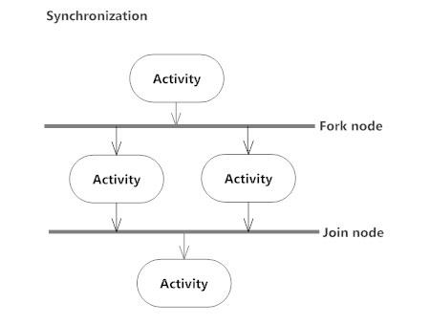
Symbols and Notations
Synchronization

Slide 159

Symbols and Notations
Time Event
This refers to an event that stops the flow for a time; an hourglass depicts it.

Slide 160
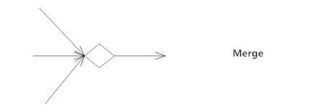

Symbols and Notations
Merge Event
A merge event brings together multiple flows that are not concurrent.
Final State or End Point
An arrow pointing to a filled circle nested inside another circle represents the final action state.

Slide 161
Symbols and Notations
Swimlane and Partition
A way to group activities performed by the same actor on an activity diagram or to group activities in a single thread

Slide 162
Activity Diagram

Slide 163
Activity Diagram with Swimlane

Slide 164
Activity Diagram without Swimlane

Slide 165
State Chart and Activity Diagram Scenarios

Slide 166
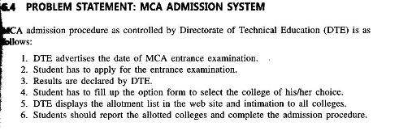

Slide 167
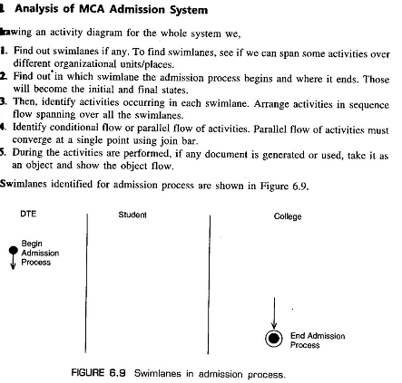

Slide 168
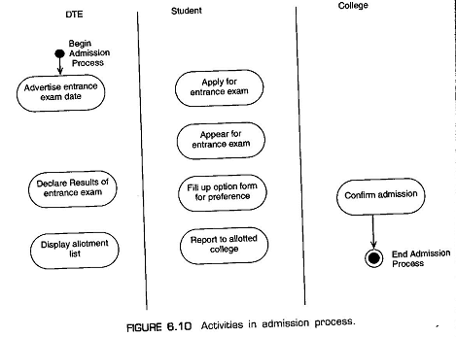

Slide 169
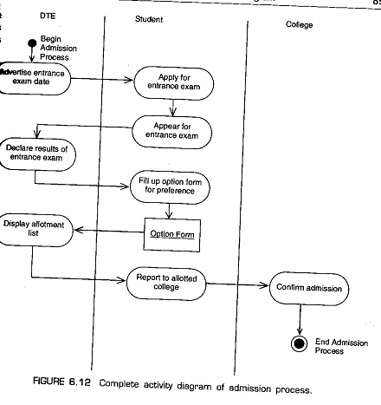

Slide 170
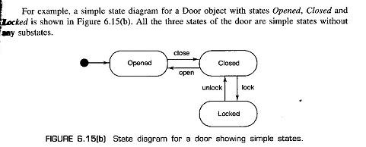
State Chart Diagram

Slide 171
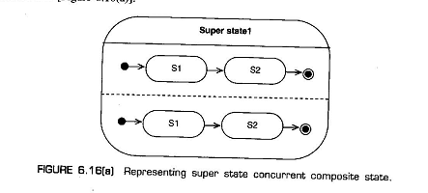

Slide 172
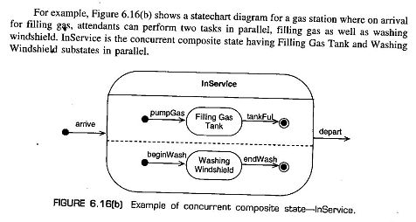

Slide 173
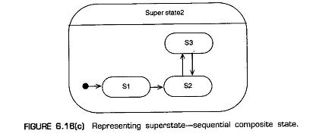

Slide 174
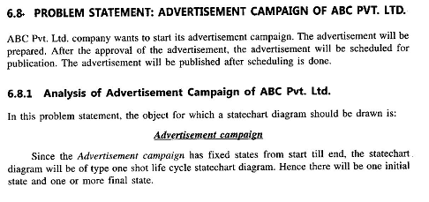

Slide 175


Slide 176
